Slide 1
A hands-on Intro to Neural Networks
presented by Emin Oguz Inci
@ MOD breakfast 08-04-2019
Codes can be found on: https://github.com/eoguzinci/NNtutorials
Notes:
Welcome you all again. My name is Emin and I will talk about Artificial Neural Networks. I am not expert in this field as Bert written that I will talk about update on my research. My PhD is about co-simulation in mechatronic systems. But for 5 years I have applied some Machine Learning algorithms to automotive field. I am doing this presentation because I thought that it might be interesting for you who would like to take an data-driven approach in your research. As AI grows in the field each, it would be nice to give a quick tutorial on what is neural networks how to use them.

Slide 2
Outline
Introduction
Some Theory
Environment Setup on Windows
Anaconda, Tensorflow, Keras
Basic examples
Simplest NN case
MNIST example with Tensorflow
Traffic Sign Detection with Tensorflow
Notes:
Here is my outline first, I will talk what is AI and where can we position Neural networks in it. Then, I will some background information and theory on neural networks. After then, we will go to the hands-on part. First, Iwill show you to set up an environment for neural networks research on your Windows machine. Then, if time remains and I hope it does, we will through several examples on how to implement.

Slide 3
What is AI and what is NOT
“AI is about building intelligent machines” Norvig
Types of intelligence
NOT MAGIC! A data-driven probabilistic optimization approach
It is a REALITY more than a HYPE (esp. when combined model-based approach)
Many consequences ahead (pros-cons)
Better to be ready for change!
Narrow: specific tasks only, e.g. Deep Blue, Alpha Go
General: broader spectrum with transferrable knowledge
Superintelligence: No need for human assistance
Notes:
Before starting talk about neural networks, it is best to define what AI is.

Slide 4
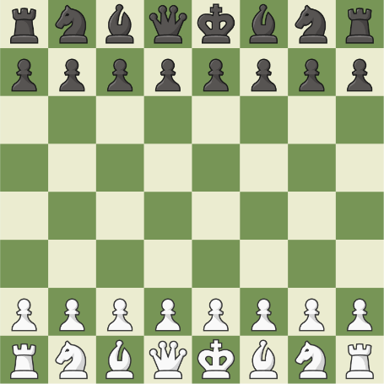

Introduction
ARTIFICIAL INTELLIGENCE
MACHINE LEARNING
Building intelligent machines
Games: Board, Console
e.g. Deep Blue
Building intelligent machines “that can learn”
Website Indexing, Spam e-mails

Slide 5

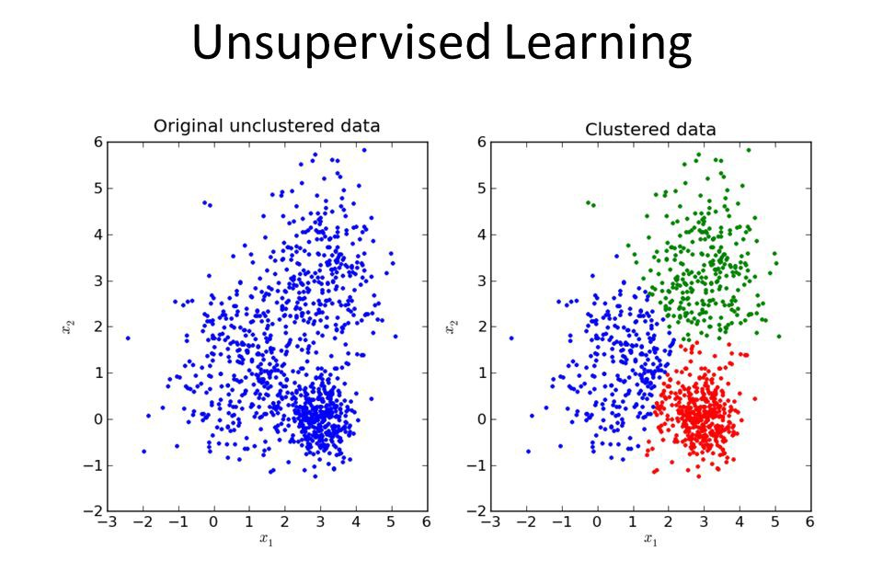
Introduction
Supervised Learning
labeled data (requires ground truth)
Suitable for Classification (discrete) or Regression (continuous)
Unsupervised Learning
No labeled data
Best for clustering (discrete) and dimensionality reduction (cont.)
Notes:
We split learning in 2 categories:
The supervised learning depends on a reference solution of the input provided to the machine to learn.
In unsupervised learning, there is no ground truth that we

Slide 6
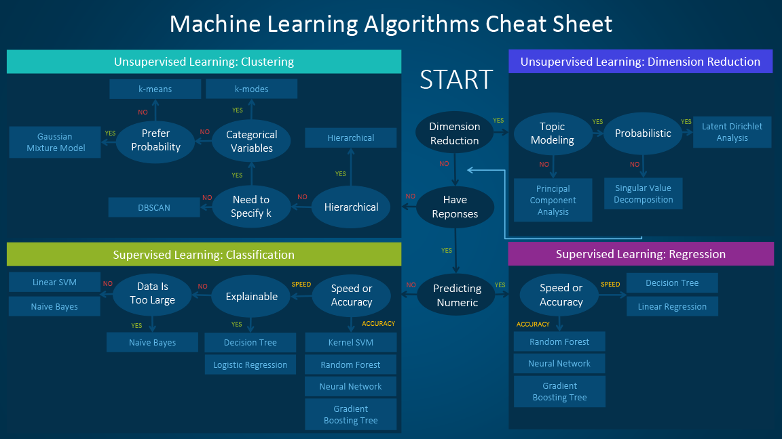

Slide 7
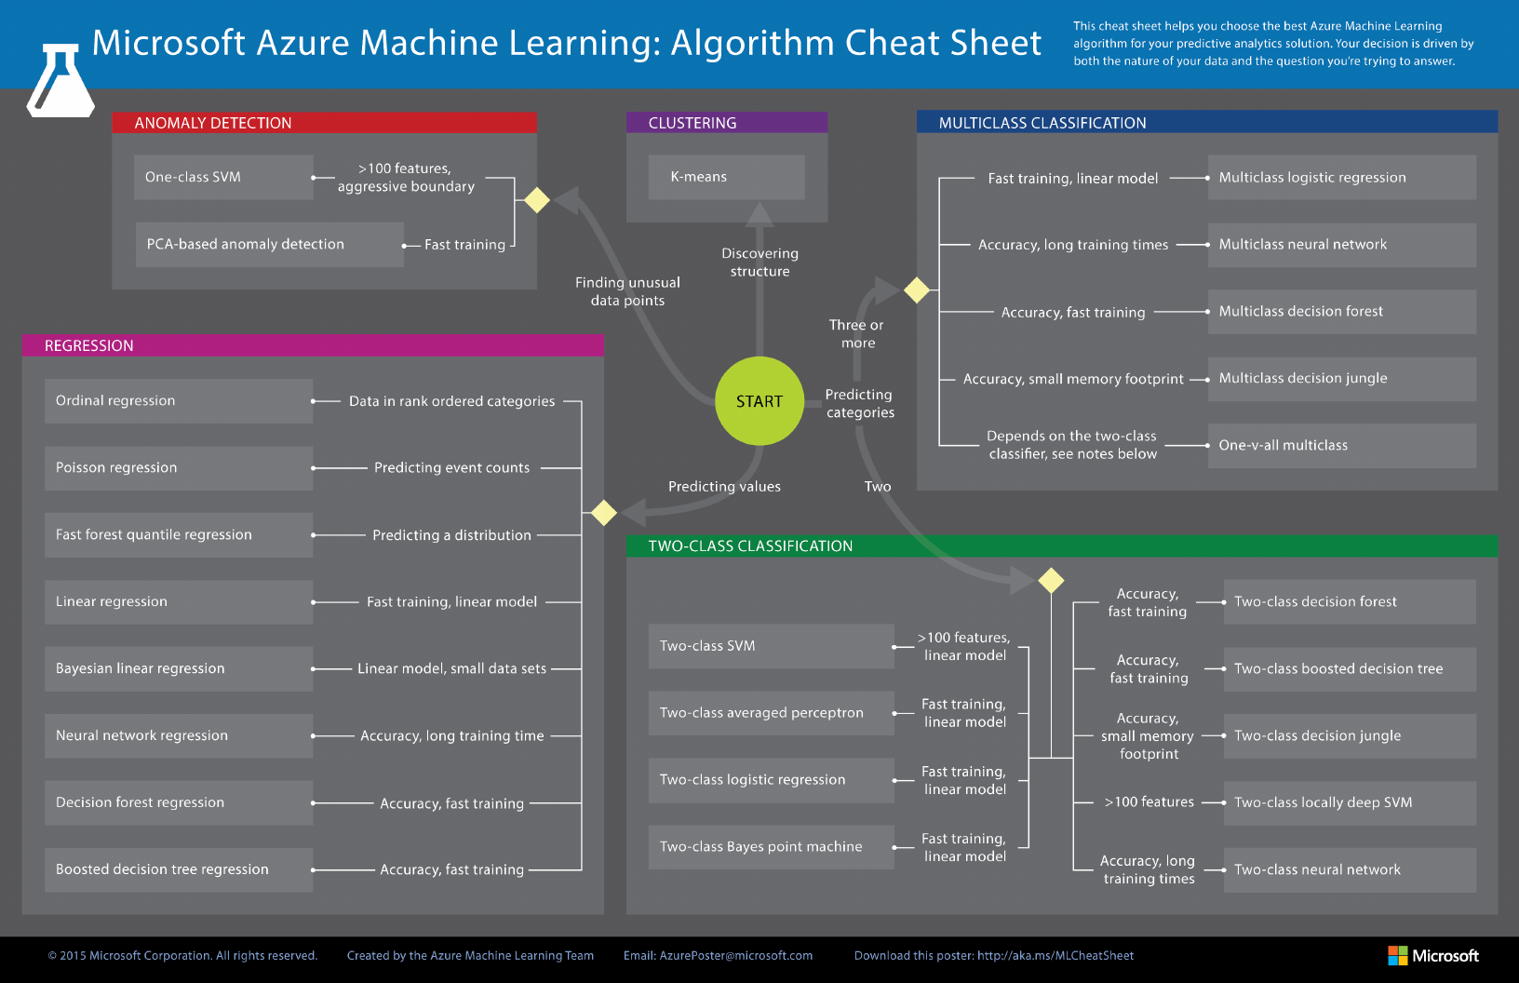

Slide 8
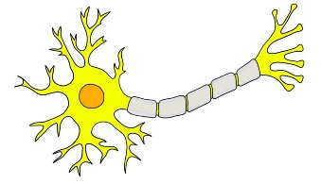
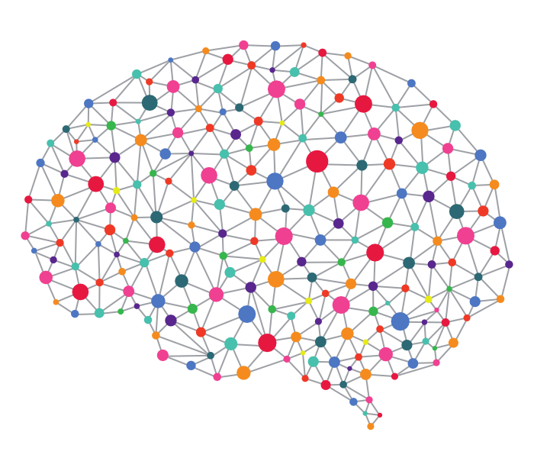
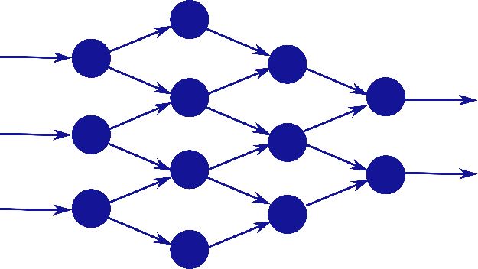
Introduction
ARTIFICIAL INTELLIGENCE
MACHINE LEARNING
NEURAL NETWORKS
Building intelligent machines
Games: Board, Console
e.g. Deep Blue
Building intelligent machines “that can learn”
Website Indexing, Spam e-mails
Building intelligent machines that can learn “like we do”
Computer Vision, Speech Recognition, Finance, Healthcare, …
In future, maybe any type of job that we think of.

Slide 9
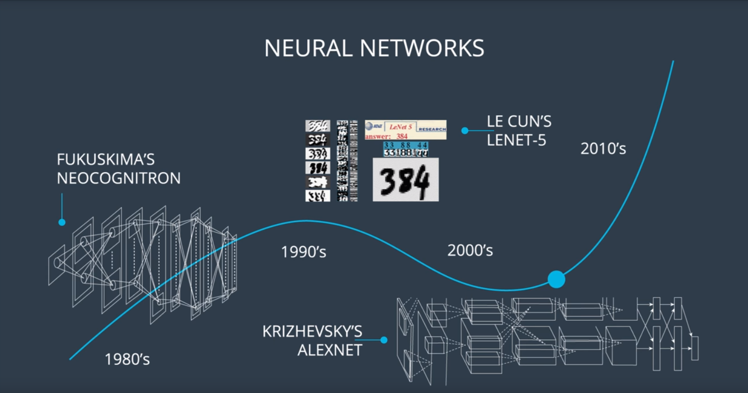

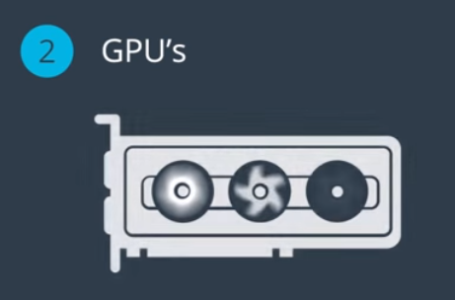
HOW?

Slide 10
Introduction
Supervised Learning
labeled data (requires ground truth)
Suitable for Classification (discrete) or Regression (continuous)
Unsupervised Learning
No labeled data
Best for clustering (discrete) and dimensionality reduction (cont.)

Slide 11
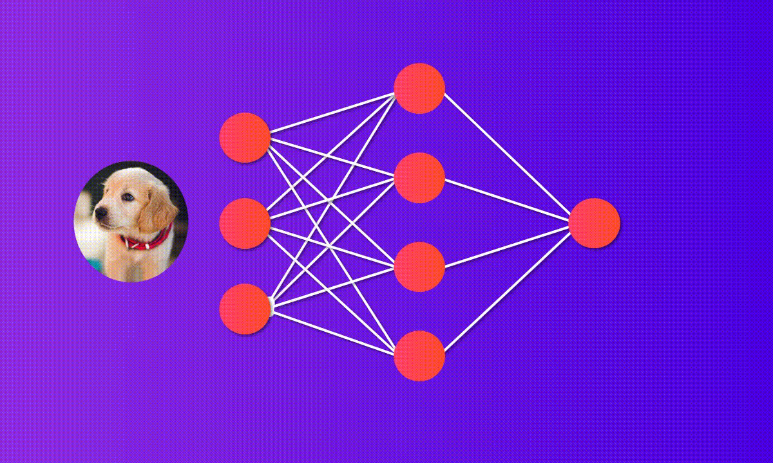
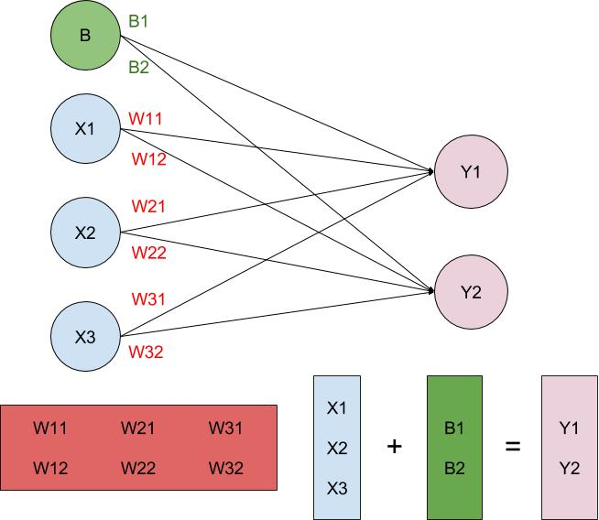
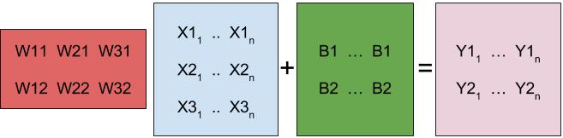
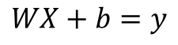

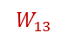
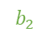
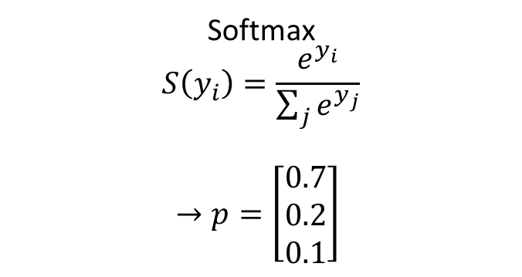
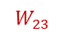
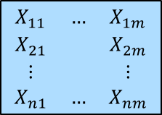
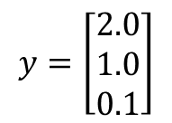
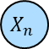

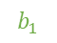
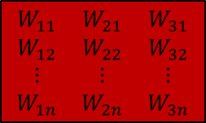

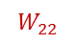
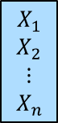
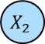
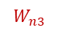
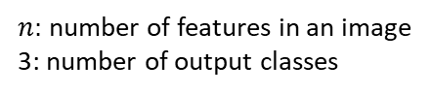
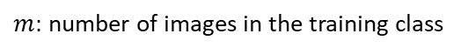
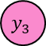
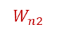
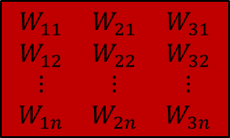
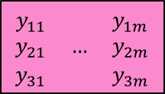

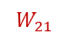
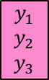


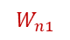
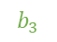
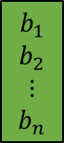
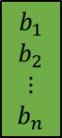
Theory
Input Layer
$$b$$
$$b_{1}$$
$$b_{2}$$
LINEAR CLASSIFIER
$$b_{3}$$
Output Layer
a
$$X_{1}$$
$$W_{11}$$
A
$$W_{12}$$
b
$$W_{13}$$
$$y_{1}$$
$$X_{2}$$
$$W_{21}$$
c
$$W_{22}$$
$$W_{23}$$
$$y_{2}$$
$$W_{n1}$$
$$W_{n2}$$
$$y_{3}$$
$$X_{n}$$
https://towardsdatascience.com/how-to-build-your-own-neural-network-from-scratch-in-python-68998a08e4f6
$$WX+b=y$$
$$W_{n3}$$
VALUES TO PROBABILITIES
Weights
Biases
Softmax
$$S\left(y_{i}\right)=\frac{e^{y_{i}}}{\sum_{j}{e^{y_{j}}}}$$
$$→p=\left[\begin{matrix}0.7 \\ 0.2 \\ 0.1\end{matrix}\right]$$
$$\begin{matrix}W_{11} & W_{21} & W_{31} \\ W_{12} & W_{22} & W_{32} \\ ⋮ & ⋮ & ⋮ \\ W_{1n} & W_{2n} & W_{3n}\end{matrix}$$
$$\begin{matrix}X_{1} \\ X_{2} \\ ⋮ \\ X_{n}\end{matrix}$$
$$\begin{matrix}b_{1} \\ b_{2} \\ ⋮ \\ b_{n}\end{matrix}$$
$$\begin{matrix}y_{1} \\ y_{2} \\ y_{3}\end{matrix}$$
+
=
$n:$ number of features in an image
3: number of output classes
$$y=\left[\begin{matrix}2.0 \\ 1.0 \\ 0.1\end{matrix}\right]$$
$$\begin{matrix}W_{11} & W_{21} & W_{31} \\ W_{12} & W_{22} & W_{32} \\ ⋮ & ⋮ & ⋮ \\ W_{1n} & W_{2n} & W_{3n}\end{matrix}$$
$$\begin{matrix}X_{11} & … & X_{1m} \\ X_{21} & & X_{2m} \\ ⋮ & & ⋮ \\ X_{n1} & … & X_{nm}\end{matrix}$$
$$\begin{matrix}b_{1} \\ b_{2} \\ ⋮ \\ b_{n}\end{matrix}$$
$$\begin{matrix}y_{11} & & y_{1m} \\ y_{21} & … & y_{2m} \\ y_{31} & & y_{3m}\end{matrix}$$
+
=
$m:$ number of images in the training class
Notes:
Assume that we have a linear classifier takes this image to make prediction whether it is a,b or c. This linear function is a big matrix multiplier. It take input denoted as x, multiples with a matrix storing weights for each input feature and add biases to make predictions. To make the best predictions we need to find the weights and biases. This optimization is called training. Before we go to training let’s assume that we have good enough weights and biases and with them we get such an output vector. How do we turn them to verdicts? We need to convert these outputs t probabilities for this reason we can use softmax function.

Slide 12
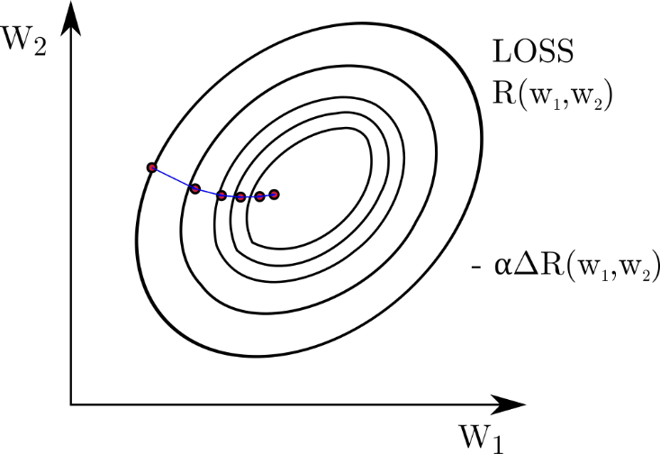
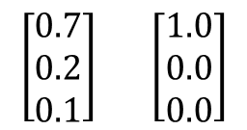
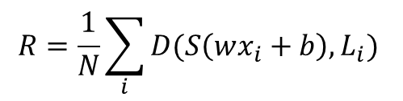
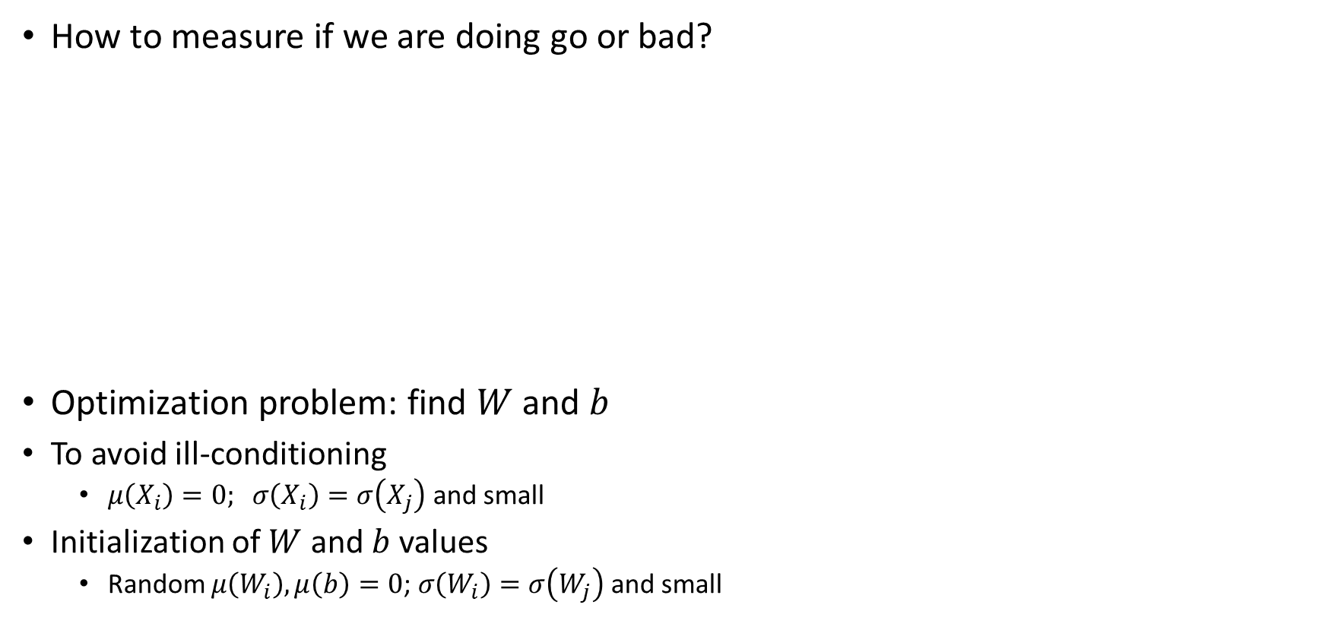
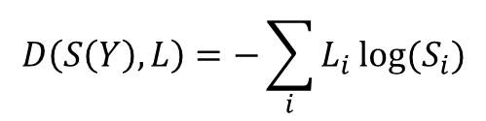
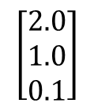
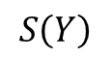
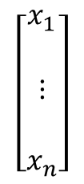
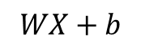
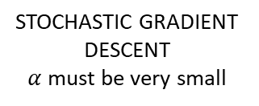
Theory
How to measure if we are doing go or bad?
Optimization problem: find $W$ and $b$
To avoid ill-conditioning
$μ\left(X_{i}\right)=0; σ\left(X_{i}\right)=σ\left(X_{j}\right)$ and small
Initialization of $W$ and $b$ values
Random $μ\left(W_{i}\right),μ\left(b\right)=0$; $σ\left(W_{i}\right)=σ\left(W_{j}\right)$ and small
INPUT
LOGITS
PROBs
ONE-HOT ENCODED LABEL
CROSS ENTROPY
$$\left[\begin{matrix}x_{1} \\ \\ ⋮ \\ \\ x_{n}\end{matrix}\right]$$
$$\left[\begin{matrix}2.0 \\ 1.0 \\ 0.1\end{matrix}\right]$$
$$\left[\begin{matrix}0.7 \\ 0.2 \\ 0.1\end{matrix}\right] \left[\begin{matrix}1.0 \\ 0.0 \\ 0.0\end{matrix}\right]$$
$$D\left(S\left(Y\right),L\right)=−\sum_{i}{L_{i}}log⁡(S_{i})$$
a
$$R=\frac{1}{N}\sum_{i}{D(S\left(wx_{i}+b\right),L_{i}) }$$
LOSS FUNCTION
$$WX+b$$
$$S\left(Y\right)$$
GRADIENT DESCENT
for better scaling
STOCHASTIC GRADIENT DESCENT
$α$ must be very small

Slide 13
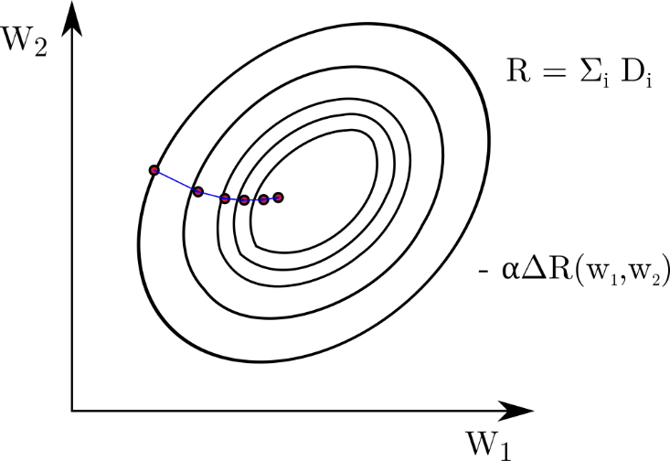
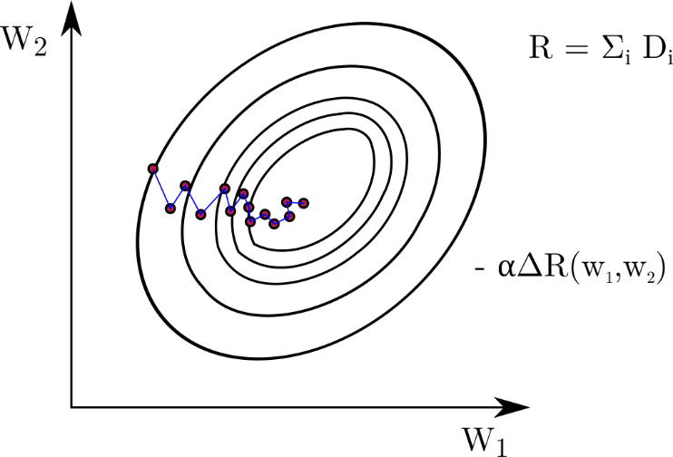



Stochastic Gradient Descent
N
ALL DATA is USED!
n
SOME RANDOM DATA is USED!
(STOCHASTIC)
$$W_{1}←W_{1}−α∇R_{1}$$
$α:$ learning rate
Larger steps
Smaller steps
Smoothing the optimization
Momentum Formulation: Running average of gradient
$$−α∇R −M_{i}=−0.9M_{i−1}−∇R_{i}$$
Learning rate decay: learning rate gets smaller in the next step
SGD Hyper-parameters
Learning Rate
Momentum
Weight Initialization
Automatic algorithms: ADAGRAD, ADAM

Slide 14



Dataset
Well conditioned for optimization process $→$ Means & std. variations
The data should not be biased
Equal # of labels in training set
Shuffle your dataset
Manual feature reduction
No wish that our classifier memorize the dataset $→$ OVERFITTING!
Split your dataset to training and testing
Training
Set
Validation
Set
Test
Set
70%
20%
10%
Notes:
Once I build a basic self-driving algorithm and it failed in the real world example because I trained my model in a circuit at which I tend to drive generally to the right.
The network can also

Slide 15







Activation Functions
Linear set of equations are handy, but we need to capture NONLINEARITY!! $→$ Activation Functions used between layers.
$Y=aX_{1}+bX_{2}$
$Y=cX_{1}X_{2}$
Image from Udacity : Deep Learning Course

Slide 16



Deep Neural Networks
Better to make your neural network deeper than wider
For efficiency reasons, smaller weight vector
So, there is hierarchy between layers and the meanings of the layers
Objects
$${ x}_{1}$$
Shapes
$${ x}_{2}$$
Lines
Image from Udacity : Deep Learning Course

Slide 17















Backpropagation
Forward propagation $g o f(x,W_{i},b)$
$$R\left(W\right)=−\frac{1}{m}\sum_{i=1}^{m}{{\overline{y}}_{i}\log\left(y_{i}\right)+\left(1−{\overline{y}}_{i}\right)\log\left(1−y_{i}\right)}$$
$$∇R_{i}=\frac{∂R}{∂g}\frac{∂g}{∂f}\frac{∂f}{∂W_{i}}$$
$$x$$
$$W_{1}$$
$$W_{2}$$
$$y$$
(Chain Rule)
$$\overline{y}$$
$$W_{1}←W_{1}−α∇R_{,1}$$
$$W_{2}←W_{2}−α∇R_{,2}$$
$$∇W_{1}$$
$$∇W_{2}$$
Back propagation $f^{′}o g′(x,W_{i},b)$
(Requires x2 memory
x2 computation)
smaller weight
greater weight
weight
sensitivity
logit
sensitivity
weight
sensitivity
logit
sensitivity

Slide 18
Training
Find reliable and large dataset
Finetune the data (Normalizing, feature extraction, etc.)
Create an NN model
Select optimizer (GD, SGD, Adagrad, Adam, etc.)
Set hyper parameters
(learning rate, momentum, weight initialization, dropout rate, etc.)
For memory concerns, divide data into mini-batches
Epoch: Single forward-backward propagation over all dataset
Several epochs: saving weights for the next epoch
Calculate loss in validation set: Measuring training accuracy
Evaluate Model: Predict the labels in test set and measure the test accuracy

Slide 19


Environment Setup on Windows (part 1)
Python 3.5+ (recommended Anaconda if not using ROS)
https://www.anaconda.com/distribution/
Tensorflow GPU (if you have Nvidia GPU)
CUDA Toolkit (https://developer.nvidia.com/cuda-downloads)
CudNN(https://developer.nvidia.com/cudnn + sign up required)
Extract the cuDNN files into your Toolkit directory.

Slide 20
Environment Setup on Windows (part 2)
Keras (User friendly, fast implementation API for Tensorflow)
Create Conda Environment (optional but highly recommended)
$ conda create -n tensorflow-gpu
$ activate tensorflow-gpu
$ pip install tensorflow-gpu (automatically installs all required packages)
$ pip install keras
Other libraries to mention
Matplotlib (data visualization), numpy (linear algebra), pandas (data analysis), scikit-learn (machine learning)

Slide 21


Basic Examples
The most basic one layer NN $→(x_{1}\&\&(x_{2}||x_{3})$
Inputs: $\begin{matrix}[0 & 0 & 1] \\ [1 & 1 & 1] \\ [1 & 0 & 1] \\ [0 & 1 & 1]\end{matrix}$ Labels: $\left[\begin{matrix}0 \\ 1 \\ 1 \\ 0\end{matrix}\right]$ Find $y$ if $x=[\begin{matrix}1 & 1 & 0\end{matrix}]$ .
Training MNIST dataset in one layer NN
Predicting hand written digits
4

Slide 22


Elaborate Example
Traffic Sign Detection with Convolutional Neural Networks
INPUT:
It is a STOP SIGN!

